Slide 1
Usability Testing
Foundations of software testing
Łukasz Urbaniak
25.11.2016

Slide 2
AGENDA
What is usability ?
Why it is so important?
How to test and measure it ?
Accesibility

Slide 3
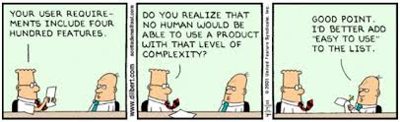
What is usability ?
Usability Testing
The international standard, ISO 9241-11, provides guidance on usability and defines it as:
The extent to which a product can be used by specified users to achieve specified goals with effectiveness, efficiency and satisfaction in a specified context of use.
5 elements of usability by Jakob Nielsen
Learnability:
How easy is it for users to accomplish basic tasks the first time they encounter the design?
Efficiency:
Once users have learned the design, how quickly can they perform tasks?
Memorability:
When users return to the design after a period of not using it, how easily can they re-establish proficiency?
Errors:
How many errors do users make, how severe are these errors, and how easily can they recover from the errors?
Satisfaction:
How pleasant is it to use the design?
Easy to use:

Slide 4

Why its so important?
Usability Testing
On the web and in the mobile industry usability is a precondition for survival
Users no longer tolerate websites that are slow to load, ugly to look at, and difficult to navigate. If your website is not usable, there are thousands of others out there that are
Usability can save time, money and even lives...
85% abandon a site due to poor design
83% leave because it takes too many clicks to get what they want
62% gave up looking for an item while shopping online
40% never return to a site because the content was hard to use
50% of sales are lost because visitors can’t find content

Slide 5
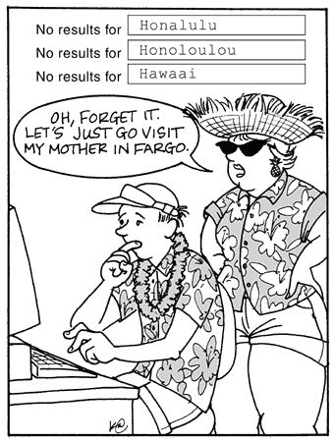
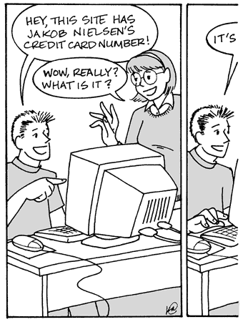
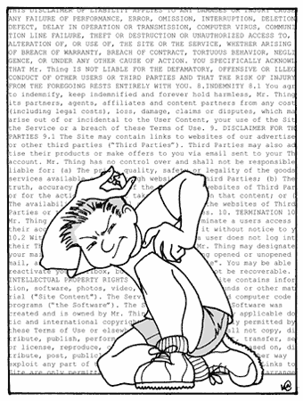
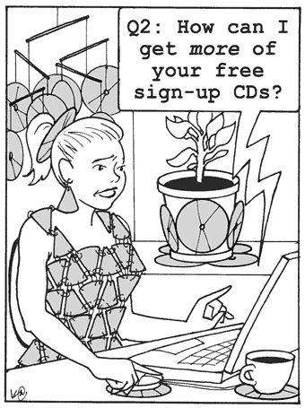
Common usability mistakes
Usability Testing
Bad search
Horizontal scrollbar
Not scanable text
Infrequently asked questions

Slide 6
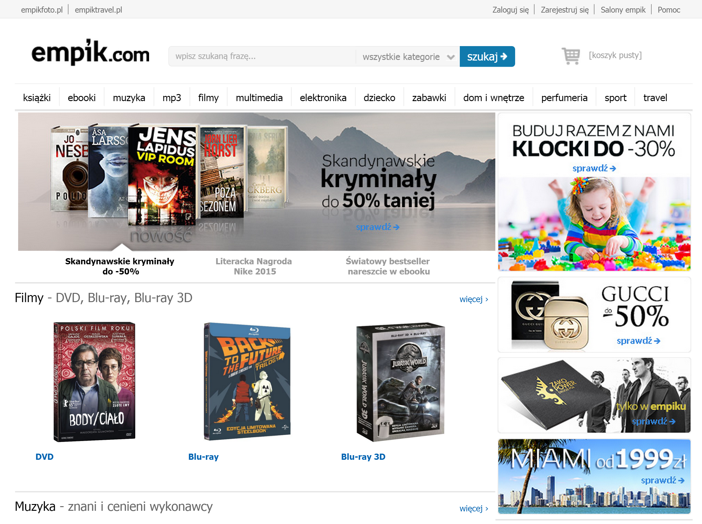
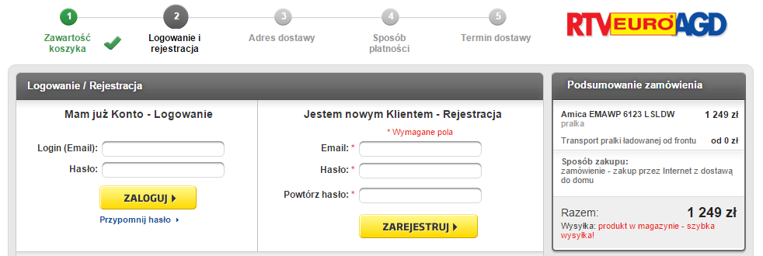
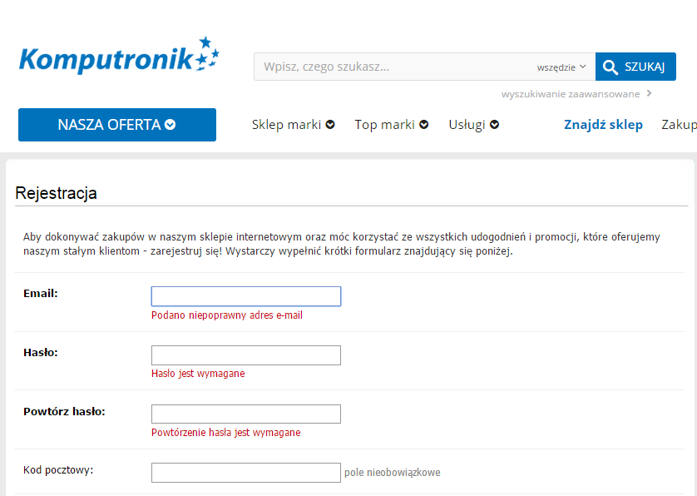
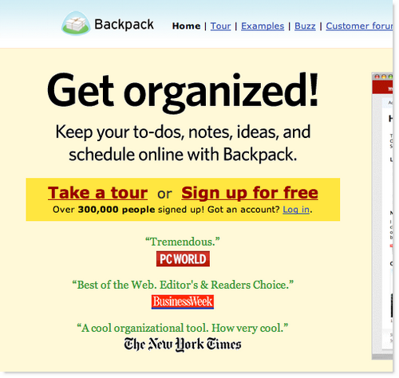
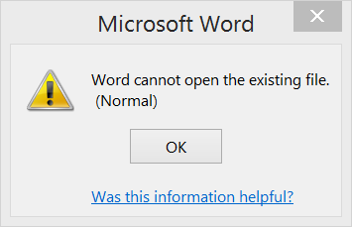
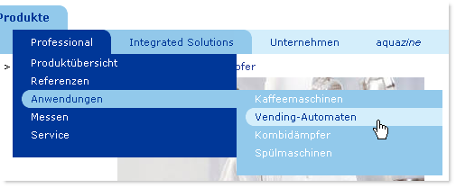
Common usability mistakes – real examples
Usability Testing

Slide 7
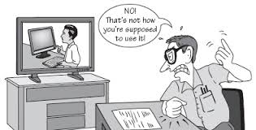
What is usability testing?
Usability Testing
is a type of Non-Functional testing
is a technique used to evaluate a product by testing it on users
It evaluates if the interface is user-friendly
It gives back the information if the user can complete tasks successfully and with ease
Main Goal:
◦ identify any usability problems
◦ collect quantitative data on participants' performance
◦ determine participant's satisfaction with the product

Slide 8
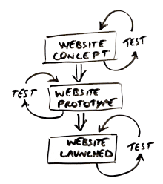
When and how?
Usability Testing
WHEN
Should start as early as possible (checking prototypes)
Should iterate together with development
Conducted also at the end of development stage to evaluate usability of a product
HOW
Decide what to test
Recruit users
Design tasks for them
Conduct testing sessions using chosen techinque
Get immediate feedback

Slide 9
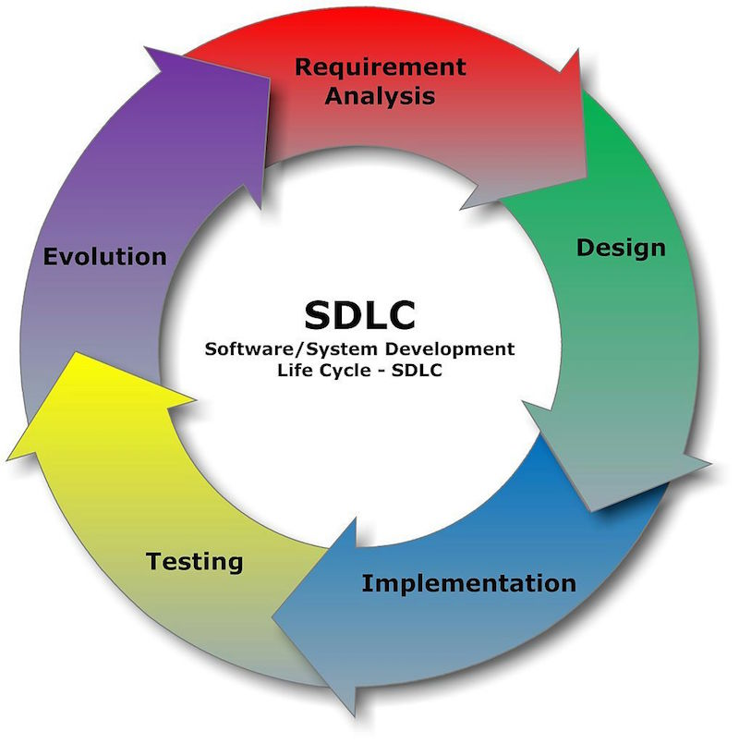
Usability Engineering Lifecycle
Usability Testing
Waterfall model does not work!
Iterative model
Repeatable and continously improved requirements analysis with engagement of targeted users in user testing helps to create user friendly product
Analysis and concept phase
Design and prototyping phase
Evaluation phase
The lifecycle approach to UX design
http://blog.invisionapp.com/lifecycle-approach-to-ux-design/

Slide 10
Advantages of Usability Testing
Usability Testing
Client expectations:
applications have to be easy and intuitive to use
applications have to be easy to understand
Costs reduction:
usability = less complex and easier in use products
less complex products can be easier sold and addressed for wider audience
Usability testing:
saves time of improving and developing
decreasses unwanted stress in project team
defines important (and unimportant) criteria for users
helps to find week sides and defects in early stages

Slide 11
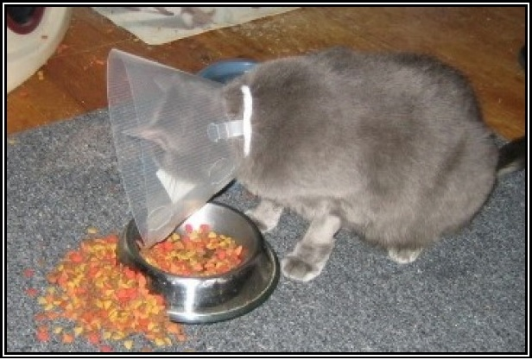
Problems with Insufficient Usability
Usability Testing
Medical devices:
insufficient configuration may put the patients at rist
Aeroplanes:
switches and buttons in airplane cockpit have to be easily accessible even in stresfull situations
status indicators must be quickly undestendable
Electronic shops:
usability have direct impact on sale
inability in finding base shop functions (i.e. shop cart or ordering form), finding products might cause lose in sales

Slide 12
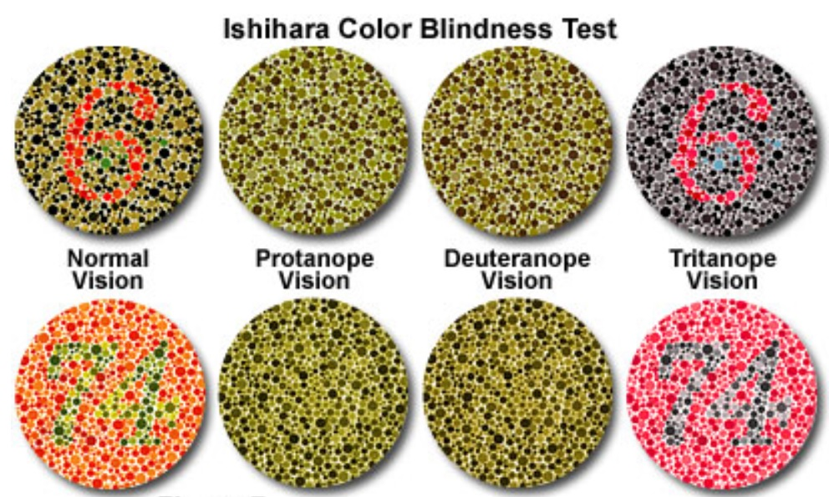
Color Blindness Test
Usability Testing
http://micro.magnet.fsu.edu/primer/lightandcolor/humanvisionintro.html

Slide 13
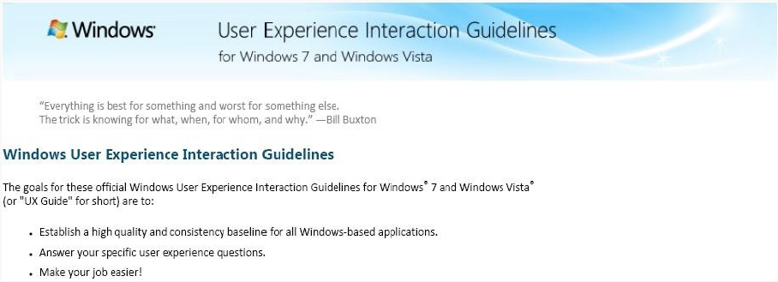
Style guides
Usability Testing
Style guides = industry standards connected with organisation
Bases on organisation design
Defines understandable guidelines regarding desiging printed materials and web pages of organisations
Specification can consist of:
colors definition
templates of mail correspondence
principles for source code of desktop applications and web pages
result = unified appearance of all applications in organisation

Slide 14
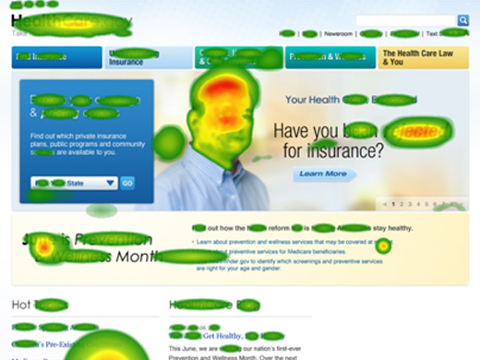
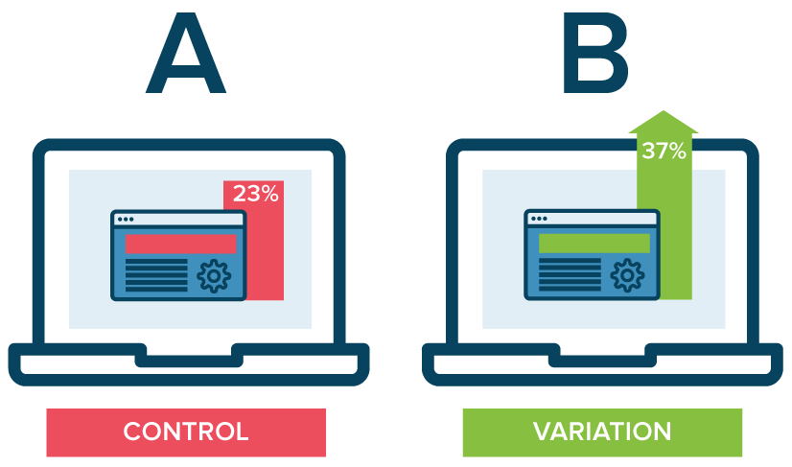
Testing Techniques?
Usability Testing
5 SECOND TEST
• What is the purpose of the website/app?
• Name 3 things you can do with this website
• Who does this site or app belong to?
• How do you feel about this organisation?
THINK\TALK-ALOUD
Participants in testing express their thoughts\actions on the application while executing set tasks.
CHECKLIST
Commonly used for websites testing
Allows verification whether applications works or not
A/B TEST
Comparing two versions of given feature or whole website
EYE TRACKING

Slide 15
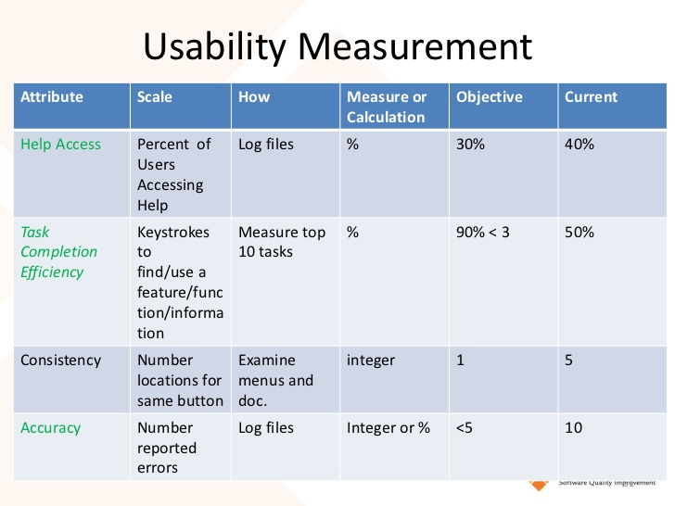
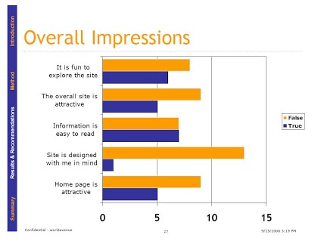
Metrics
Usability Testing
Measuring Usability:
Task success
Perceived success
Confusion moment
Menu/Navigation use
Back button usage
Time on task
Error rate

Slide 16
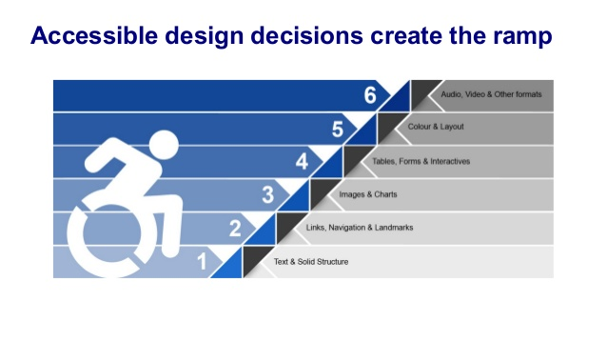
Web Accesibility – how to check?
Usability Testing
http://achecker.ca/checker/index.php
http://wave.webaim.org/
http://juicystudio.com/services/luminositycontrastratio.php
https://www.mencap.org.uk/learning-disability-explained/
http://www.dyslexic.com/fonts/

Slide 17
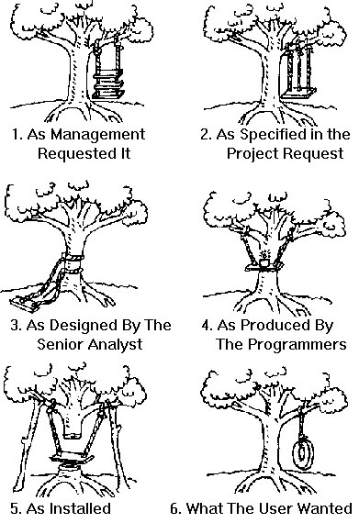
What is it for?
Usability Testing

Slide 18
Excercise at home – become usability tester
Usability Testing
Sign in to one of the usability crowd source testing platforms
Set-up your profile and conduct usability session for given project
Recorded report send to: https://github.com/jacekokrojek/math.uni.lodz.pl-2016
Example platforms:
http://whatusersdo.com/panel/
http://www.trymyui.com/worker/signup
https://www.usertesting.com/be-a-user-tester
https://www.userlytics.com/tester/

Slide 19
Łukasz Urbaniak
GFT
Lukasz.Urbaniak@gft.com

